Slide 1

Crypto CEX Intro & Spot Data
Prof. Yang You
HKU Business School

Slide 2
Introduction of Cryptocurrency Centralized Exchange (CEX)
History & Evolution (2010~)
Core Product Categories of CEX
Key Risk Factors, Advantages/Disadvantages
Leading CEXs

Slide 3
CEX HISTORY & EVOLUTION (2010~)
EARLY DAYS (2010-2014): Pioneering & Vulnerability
BitcoinMarket.com Launch (2010) - The world's first cryptocurrency exchange went live on March 17, 2010, created by user "dwdollar." It established peer-to-peer trading and allowed the market to set Bitcoin prices based on supply and demand, using PayPal and an escrow system. Bitcoin was valued at just $0.003 per coin at launch.
Basic Fiat Ramps - Early exchanges introduced the first methods to convert between Bitcoin and traditional fiat currencies (primarily USD), establishing the foundation for cryptocurrency markets.

Slide 4
CEX HISTORY & EVOLUTION (2010~)
EARLY DAYS (2010-2014): Pioneering & Vulnerability
Mt. Gox Dominance (2013) - Mt. Gox became the dominant exchange, handling over 70% of all Bitcoin transactions worldwide by early 2013, establishing centralized exchanges as the primary trading infrastructure.
Mt. Gox Collapse (2014) - In February 2014, Mt. Gox suspended trading and filed for bankruptcy after losing approximately 850,000 BTC (~$850k at the time). Investigation revealed that bitcoins were stolen directly from the exchange's hot wallet over time, beginning in late 2011. This catastrophic failure exposed vulnerabilities in early exchange security and highlighted the risks of centralization.

Slide 5
CEX HISTORY & EVOLUTION (2010~)
GROWTH ERA (2015-2020)
Altcoin Exchanges Boom (2017) - The ICO (Initial Coin Offering) boom and emergence of forked coins drove explosive trading demand. Major exchanges like Binance, Gate.com, and OKX launched in 2017. The altcoin season saw Ethereum surge from $8 to over $1,400, XRP from $0.006 to $3.50, and Litecoin from $4 to $360, driving massive interest in alternative cryptocurrency trading.
Futures and Perpetuals - Exchanges introduced sophisticated trading products including futures contracts and perpetual swaps, attracting professional traders and increasing market liquidity.

Slide 6
CEX HISTORY & EVOLUTION (2010~)
GROWTH ERA (2015-2020)
Institutional Entry (2020) - Major turning point as mainstream institutions entered the market. PayPal allowed users to buy, hold, and sell crypto in October 2020. Grayscale's Bitcoin Trust (GBTC) saw record assets under management. Square's Cash App and PayPal combined were buying more than 100% of newly mined Bitcoin, creating supply pressure and legitimizing crypto for mainstream adoption.

Slide 7
CEX HISTORY & EVOLUTION (2010~)
MODERN ERA (2021-NOW)
KYC/AML Standards (2023) - Exchanges entered a "compliance era" by adopting strict regulations like FinCEN and FATF guidelines, requiring robust identity verification and transaction monitoring.
Proof-of-Reserves - Platforms began publishing cryptographic proof of their holdings to demonstrate solvency and rebuild user trust.
MPC/Custody Focus - Institutional-grade custody and Multi-Party Computation (MPC) technology became the standard for securing user assets.

Slide 8
CEX HISTORY & EVOLUTION (2010~)
MODERN ERA (2021-NOW)
Bybit Hack ($1.5B) - February 2025 - North Korean Lazarus Group executed the largest crypto theft in history, stealing approximately $1.5 billion in Ethereum from Bybit exchange through a supply chain attack. Despite this massive breach, ByBit maintained operations by securing loans to replenish stolen funds, demonstrating modern exchanges' resilience and institutional backing—a stark contrast to Mt. Gox's complete collapse.

Slide 9
TRADING HOURS OF CEX
1. Core Operating Hours
24/7/365 operation - No closing times, weekends, or holidays
2. Market Activity
Peak hours - Highest volume during overlap of major financial center business hours
Off-peak volatility - Lower liquidity on weekends/nights can increase spreads and price swings
3. Maintenance Windows
Scheduled downtime - Occasional brief maintenance periods (typically 50 minutes weekly or 3-4 hours quarterly)
Emergency halts - Rare unplanned suspensions for technical issues or security incidents

Slide 10
CORE PRODUCT CATEGORIES OF CEX
1. Spot Trading
Direct asset ownership with immediate settlement (T+0)
Order book matching connects buyers and sellers in real-time
Fiat on/off ramps enable conversion between traditional currencies (USD, EUR) and cryptocurrencies
Foundation for all derivatives pricing

Slide 11
CORE PRODUCT CATEGORIES OF CEX
2. Margin Trading
Borrow funds against your existing holdings to amplify position size
Leverage ranges from 2x to 125x depending on exchange and asset
Automated liquidations trigger when collateral value falls below maintenance margin
Amplifies both gains and losses proportionally

Slide 12
CORE PRODUCT CATEGORIES OF CEX
3. Perpetual Futures
No expiration date - positions can be held indefinitely unlike traditional futures
Funding rate mechanism - periodic payments (every 8 hours) between long/short positions keep price anchored to spot
Popular for leveraged directional trading without rollover concerns

Slide 13
CORE PRODUCT CATEGORIES OF CEX
4. Dated Futures
Fixed settlement dates - typically quarterly (March, June, September, December) or monthly
Basis trading opportunities - price difference between futures and spot enables arbitrage
Settlement occurs on last Friday of quarter at 08:00 UTC

Slide 14
CORE PRODUCT CATEGORIES OF CEX
5. Options
Calls and puts for hedging downside risk or generating income
Greeks management - Delta, Gamma, Theta, Vega measure risk exposures
Requires advanced understanding of volatility and time decay
Provides asymmetric risk/reward profiles

Slide 15
CORE PRODUCT CATEGORIES OF CEX
6. OTC/Block Trading
Institutional-sized orders executed privately off public order books
RFQ (Request-for-Quote) desks provide custom pricing for large trades
Minimizes market impact and slippage for high-net-worth clients

Slide 16
CORE PRODUCT CATEGORIES OF CEX
Product Comparison
Product Type | Settlement | Leverage | Complexity | Best For
Spot | Immediate | 1x | Low | Long-term holders, beginners
Margin | Ongoing | 2x-125x | Medium | Active traders seeking leverage
Perpetuals | No expiry | 2x-125x | Medium | Directional traders
Dated Futures | Quarterly/Monthly | 2x-125x | Medium-High | Basis traders, hedgers
Options | Fixed expiry | Variable | High | Sophisticated hedgers
OTC | Negotiated | Custom | Low-Medium | Institutions, large orders

Slide 17
KEY RISK FACTORS
Leverage Risks
Magnifies both profits and losses proportionally
Example: 10% adverse move with 5x leverage = 50% portfolio loss
Liquidation Risk
Margin and futures positions face automatic closure if collateral insufficient
Can result in total loss of margin posted
Funding Costs
Perpetual contracts charge/pay funding rates every 8 hours
Costs accumulate for long-term positions in trending markets
……

Slide 18
ADVANTAGES OF CEX
1. Deep Order Books with Tight Bid-Ask Spreads
Superior liquidity depth across major and long-tail assets with minimal price impact —— top exchanges process $200B+ daily volume
Tight spreads minimize slippage, with heavily traded pairs like BTC/USDT showing spreads as low as 0.01%
2. Intuitive Interfaces for All Experience Levels
Beginner-friendly onboarding with step-by-step tutorials, fast fiat deposits via cards/bank transfers, and mobile-first design
Tiered interfaces offering simple mode for beginners and advanced charting tools for professional traders

Slide 19
ADVANTAGES OF CEX
3. High-Performance Matching Engines
Low-latency order execution settling trades in milliseconds with throughput handling millions of orders per second
24/7 uptime with robust infrastructure, API access for algorithmic trading, and 99.9%+ reliability
4. Comprehensive Product Offerings
Complete trading suite including spot, margin (up to 125x leverage), derivatives (perpetuals, futures, options), and staking/lending
One-stop platform with launchpads for new token offerings and unified portfolio management across all products

Slide 20
ADVANTAGES OF CEX
5. Regulatory Compliance Frameworks
Mandatory KYC/AML standards per FinCEN and FATF guidelines with AI-powered transaction monitoring and suspicious activity reporting
Licensed operations across jurisdictions with SOC 2 certifications, third-party audits, and regulatory oversight
6. Multiple Fiat Payment Options
Instant card purchases (Visa/Mastercard), bank transfers (ACH, SEPA, wire), and stablecoin bridges (USDC, USDT) for fast settlement
Support for 50+ fiat currencies with P2P marketplaces enabling local payment methods in emerging markets

Slide 21
DISADVANTAGES OF CEX
1. Custodial Risk
You don't own your private keys - the exchange does ("not your keys, not your coins")
Counterparty risk: the exchange could become insolvent, get hacked, or mismanage funds
Historical Evidence
Mt. Gox (2014): 850,000 BTC stolen (~$460M then, ~$50B+ at today's prices) - exchange collapsed
FTX (2022): $8B+ customer funds misappropriated - bankruptcy and fraud charges
Bybit (2025): $1.5B Ethereum stolen in North Korean hack - exchange survived via loans

Slide 22
DISADVANTAGES OF CEX
2. Privacy Loss
Mandatory identity verification required by regulators (FinCEN, FATF standards)
Exchanges collect: name, address, government ID, selfies, income/source of funds
Data stored centrally creates honeypot for attackers
Privacy Concerns
Data breaches: Coinbase (Dec 2024) - 70,000 users' KYC data compromised through bribed customer service agents
Surveillance: All trading activity monitored and can be reported to tax/regulatory agencies
Identity theft risk: Stolen KYC documents used for fraud
No anonymity: Unlike decentralized alternatives, CEX trading is fully traceable

Slide 23
DISADVANTAGES OF CEX
3. Regulatory Risk
Exchanges operate under varying regulatory frameworks across countries
Access can be restricted based on user location (geoblocking)
Regulatory changes can suddenly limit services or force closures
Documented patterns
Binance: Banned or restricted in multiple jurisdictions (US, UK, Japan, China) - notorious for jurisdiction shopping
FTX: Relocated to Bahamas to avoid stricter US regulations - collapsed in 2022
US restrictions: Binance.US still banned in 6 states including New York and Texas
Service withdrawals: Exchanges regularly exit markets due to regulatory pressure

Slide 24
SPOT TRADING FEES AND VIP PROGRAMS
Exchange | Lowest Tier (spot) | Fee at lowest tier (Maker/Taker) | Main req. for lowest tier | Highest tier (spot) | Fee at highest tier (Maker/Taker) | Main req. for highest tier
Binance | Regular User | 0.10% / 0.10% | 30D trade volume < $1M or BNB Balance ≥ 0 | VIP 9 | 0.011% / 0.023% | 30D trade volume ≥ $4B or BNB Balance ≥ 5,500
Coinbase | Intro 1 | 0.60% / 1.20% | 30D spot volume ≥ $0 or 30D derivatives volume ≥ $0 or assets balance ≥ $0 | VIP 8 | 0.000% / 0.020% | 30D spot volume ≥ $250M or 30D derivatives volume ≥ $250M
OKX | Regular User | 0.08% / 0.10% | Assets (USD) ≤ $100K or 30D derivatives volume ≤ $1M | VIP 9 | -0.0075% / 0.0175% | 30D trade volume ≥ $5B
Bybit | VIP 0 | 0.10% / 0.10% | 30D spot volume ≤ $1M or 30D derivatives volume ≤ $10M or 30D options volume ≤ $5M | Supreme VIP | 0.0300% / 0.0450% | 30D spot volume ≥ $100M or 30D derivatives volume ≥ $500M or 30D options volume ≥ $100M
Bitget | VIP 0 | 0.10% / 0.10% | 30D spot volume ≥ $0 or daily balance ≥ $0 or 30D daily balance ≥ $0 | VIP 7 | 0% / 0.03% | 30D spot volume ≥ $100M or daily balance ≥ $10M or 30D asset balance ≥ $10M
BitMart | Regular User | 0.10% / 0.10% (Class-A Pair) | 30D spot volume < $20K or 30D contract volume < $20K or asset balance < $10K | VIP 8 | 0.015% / 0.02% (Class-A Pair) | 30D spot volume ≥ $50M or 30D contract volume ≥ $1B or asset balance ≥ $5M

Slide 25
PERPETUAL FUTURES (USDT-M) FEES
Exchange | Lowest Tier (spot) | Fee at lowest tier (Maker/Taker) | Main req. for lowest tier | Highest tier (spot) | Fee at highest tier (Maker/Taker) | Main req. for highest tier
Binance | Regular User | 0.02% / 0.05% | 30D trade volume < $15M or BNB Balance ≥ 0 | VIP 9 | 0.000% / 0.017% | 30D trade volume ≥ $25B or BNB Balance ≥ 5,500
Coinbase (International Exchange Fees) | Public Tier 10 | 0.02% / 0.04% | 30D Perps volume ≥ $0 | Public Tier 1 | 0.000% / 0.015% | 30D Perps volume ≥ $20B
OKX | Regular User | 0.08% / 0.10% | Assets (USD) ≤ $100K or 30D derivatives volume ≤ $1M | VIP 9 | -0.0075% / 0.0175% | 30D trade volume ≥ $5B
Bybit | VIP 0 | 0.02% / 0.055% | 30D spot volume ≤ $1M or 30D derivatives volume ≤ $10M or 30D options volume ≤ $5M | Supreme VIP | 0.00% / 0.03% | 30D spot volume ≥ $100M or 30D derivatives volume ≥ $500M or 30D options volume ≥ $100M
Bitget | VIP 0 | 0.02% / 0.06% | 30D futures volume ≥ $0 or daily balance ≥ $0 or 30D daily balance ≥ $0 | VIP 7 | 0% / 0.02% | 30D futures volume ≥ $1B or daily balance ≥ $10M or 30D asset balance ≥ $10M
BitMart | Regular User | 0.02% / 0.06% | 30D spot volume < $20K or 30D contract volume < $20K or asset balance < $10K | VIP 8 | 0.014% / 0.03% | 30D spot volume ≥ $50M or 30D contract volume ≥ $1B or asset balance ≥ $5M

Slide 26
LEADING CEXs
Exchange | Licenses/Regions | Core Products | Fees | Proof-of-Reserves | Notable Features
Binance | Global (150+ countries); UAE, France, Italy, Spain licenses; US-restricted | Spot, margin, perpetuals, options, staking, earn, launchpad | Tiered 0-0.1% maker/taker; VIP discounts; BNB fee reduction | Yes (monthly PoR) | 600+ pairs, deepest liquidity, Binance Launchpad, institutional APIs, BNB ecosystem
Coinbase | US (all 50 states), EU, UK, Canada, Singapore; publicly traded (NASDAQ: COIN) | Spot, derivatives (intl), staking, custody, Prime (institutional) | 0.4-0.6% retail; 0-0.35% advanced; lower for institutions | Yes (quarterly) | Strong compliance, user-friendly, Coinbase Custody, institutional grade, fiat ramps
OKX | Global (ex-US); Malta, Bahamas, UAE licenses; 180+ countries | Spot, perpetuals, options, copy trading, earn, Web3 wallet | Tiered 0.08-0.1% maker/taker; VIP up to 0.02% | Yes (monthly) | Advanced derivatives, Web3 wallet integration, competitive fees, strong retail tools
Kraken | US, EU, UK, Canada, Australia; FCA, FinCEN, FINTRAC registered | Spot, margin, futures (non-US), staking, OTC | 0-0.26% maker/taker tiered; volume discounts | Yes (PoR pioneer since 2014) | Security-first approach, strong fiat support, institutional OTC, PoR transparency leader
Bybit | Global (ex-US); Dubai, Cyprus licenses; 160+ countries | Spot, perpetuals, options, copy trading, NFT marketplace | 0.02-0.075% maker/taker; competitive derivatives fees | Yes (monthly) | Derivatives focus, copy trading popular, active retail community, trading competitions
Bitget | Global (ex-US); 100+ countries; various local licenses | Spot, perpetuals, copy trading, launchpad | 0.02-0.1% maker/taker; copy trading fees separate | Yes | Copy trading leader, BGB token ecosystem, derivatives focused, growing user base

Slide 27
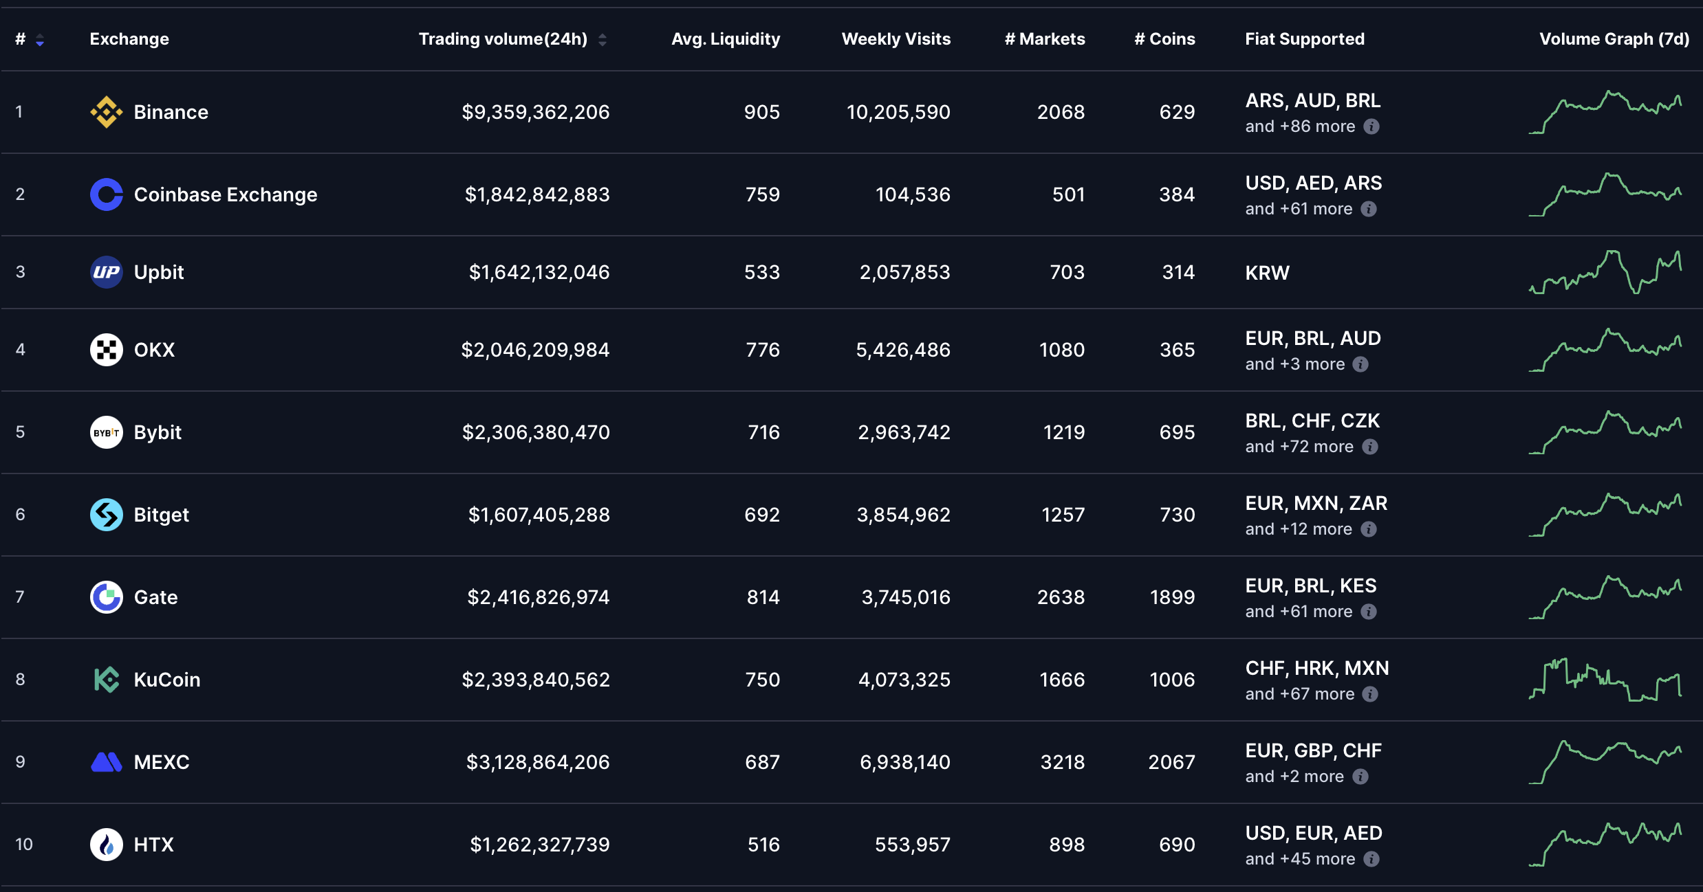
LEADING CEXs (2026-03-01 by coinmarketcap.com)

Slide 28
CEX Spot Data
Open, High, Low, Close and Volume (1-min OHLCV)
Order Book (1-min Snapshots)
Tick-by-Tick Trades

Slide 29
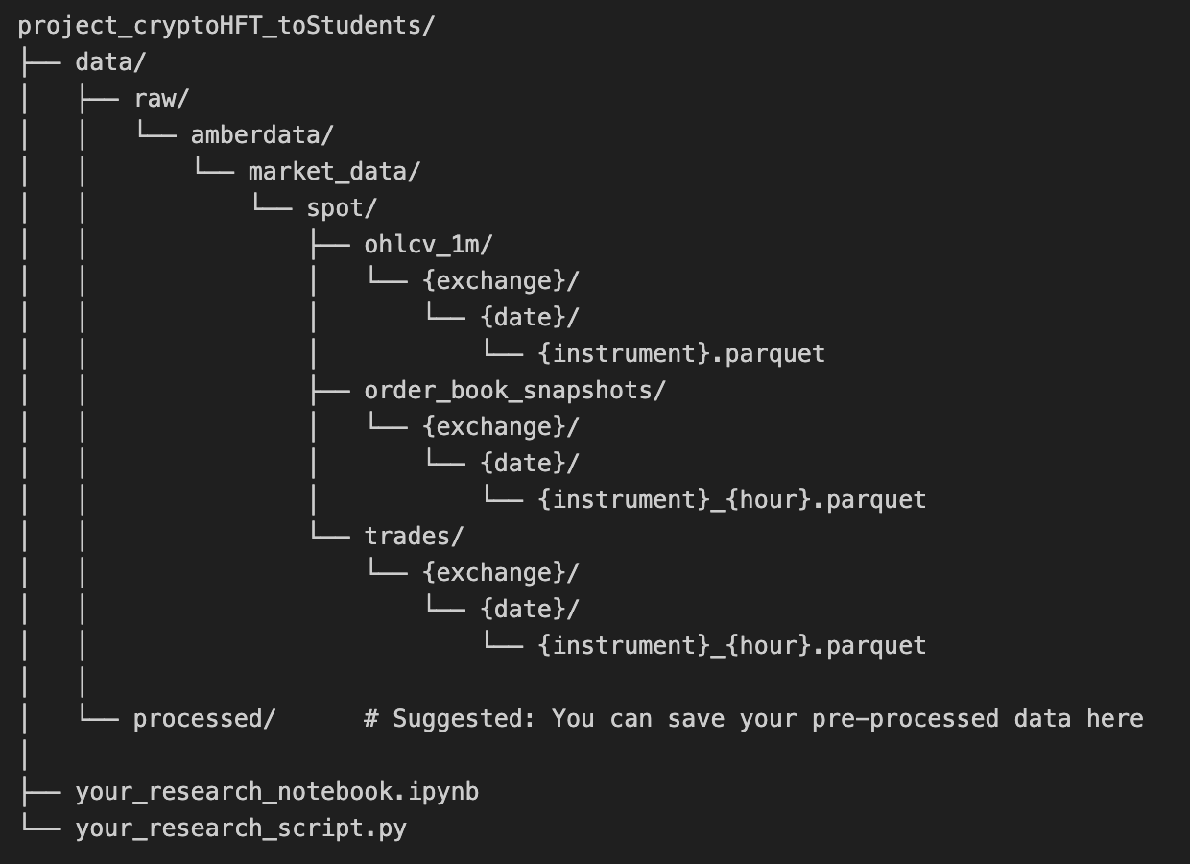
FILE STRUCTURE
Shared folder: https://www.dropbox.com/scl/fo/wrkuqu4fi5876rfhhngz6/AAqSNC5YZYDDhozhjU4FQaQ?rlkey=0aojdkzzcvfpzdkfuz7nkiagf&st=zlf07olq&dl=0
Suggested File Structure:

Slide 30
MARKET DATA COVERAGE
1. Spot – 1-min OHLCV
Exchange | Instrument | Start Date | End Date
Binance | ETH/USDT | 2022-01-01 | 2026-02-26
 | PAXG/USDT | 2020-08-28 | 2026-02-26
Bitget | ETH/USDT | 2022-01-01 | 2026-02-26
BitMart | ETH/USDT | 2022-08-01 | 2026-02-26
Bybit | ETH/USDT | 2022-01-01 | 2026-02-26
OKX | XAUT/USDT | 2022-07-19 | 2026-02-26

Slide 31
MARKET DATA COVERAGE
2. Spot – Order Book (1-min Snapshots)
Exchange | Instrument | Start Date | End Date
Binance | ETH/USDT | 2025-09-01 | 2026-02-26
Bitget | ETH/USDT | 2025-09-01 | 2026-02-26
BitMart | ETH/USDT | 2025-09-01 | 2026-02-26
Bybit | ETH/USDT | 2025-09-01 | 2026-02-26

Slide 32
MARKET DATA COVERAGE
3. Spot – Trades
Exchange | Instrument | Start Date | End Date
Binance | ETH/USDT | 2025-09-01 | 2026-02-26
 | PAXG/USDT | 2025-09-01 | 2026-02-26
Bitget | ETH/USDT | 2025-09-01 | 2026-02-26
BitMart | ETH/USDT | 2025-09-01 | 2026-02-26
Bybit | ETH/USDT | 2025-09-01 | 2026-02-26
OKX | XAUT/USDT | 2025-09-01 | 2026-02-26

Slide 33
1-MIN OHLCV
Definition
OHLCV is an aggregated form of market data standing for Open, High, Low, Close and Volume. OHLCV data is provided with minutely granularity.
Sample Data (ETH/USDT, Binance, 2026-02-01)
exchangeTimestamp | open | high | low | close | volume
1756684800000 | 4391.83 | 4391.83 | 4386.25 | 4389.95 | 325.8367
1756684860000 | 4389.96 | 4391.40 | 4389.68 | 4391.16 | 158.5513
1756684920000 | 4391.16 | 4391.16 | 4386.14 | 4388.19 | 187.0756
1756684980000 | 4388.19 | 4389.97 | 4386.33 | 4386.45 | 341.8429
1756685040000 | 4386.45 | 4386.45 | 4375.39 | 4376.57 | 622.3295
pd.to_datetime(1756684800000, unit='ms') # -> Timestamp('2025-09-01 00:00:00')
pd.to_datetime(1756685040000, unit='ms') # -> Timestamp('2025-09-01 00:04:00')

Slide 34
1-MIN OHLCV
Sample Data (ETH/USDT, Binance, 2026-02-01)
exchangeTimestamp | open | high | low | close | volume
1756684800000 | 4391.83 | 4391.83 | 4386.25 | 4389.95 | 325.8367
1756684860000 | 4389.96 | 4391.40 | 4389.68 | 4391.16 | 158.5513
1756684920000 | 4391.16 | 4391.16 | 4386.14 | 4388.19 | 187.0756
1756684980000 | 4388.19 | 4389.97 | 4386.33 | 4386.45 | 341.8429
1756685040000 | 4386.45 | 4386.45 | 4375.39 | 4376.57 | 622.3295
exchangeTimestamp: The time at which the 1-minute period starts. (Unit: millisecond)
open/close: The opening(first)/closing(last) price of the trading pair during that 1-minute period
high/low: The highest/lowest price reached during that 1-minute period
volume: The total quantity traded during that 1-minute period, in the base currency (e.g., BTC for a BTC-USD pair)

Slide 35
1-MIN OHLCV
Sample Data (ETH/USDT, Binance, 2026-02-01)
exchangeTimestamp | open | high | low | close | volume
1756684800000 | 4391.83 | 4391.83 | 4386.25 | 4389.95 | 325.8367
1756684860000 | 4389.96 | 4391.40 | 4389.68 | 4391.16 | 158.5513
1756684920000 | 4391.16 | 4391.16 | 4386.14 | 4388.19 | 187.0756
1756684980000 | 4388.19 | 4389.97 | 4386.33 | 4386.45 | 341.8429
1756685040000 | 4386.45 | 4386.45 | 4375.39 | 4376.57 | 622.3295
[ Important ]
For the OHLCV values, the price is always in quotes, and the volume unit is always in base. For example, if the pair was BTC-USD, then the prices returned are in USD and the volume is in BTC.

Slide 36
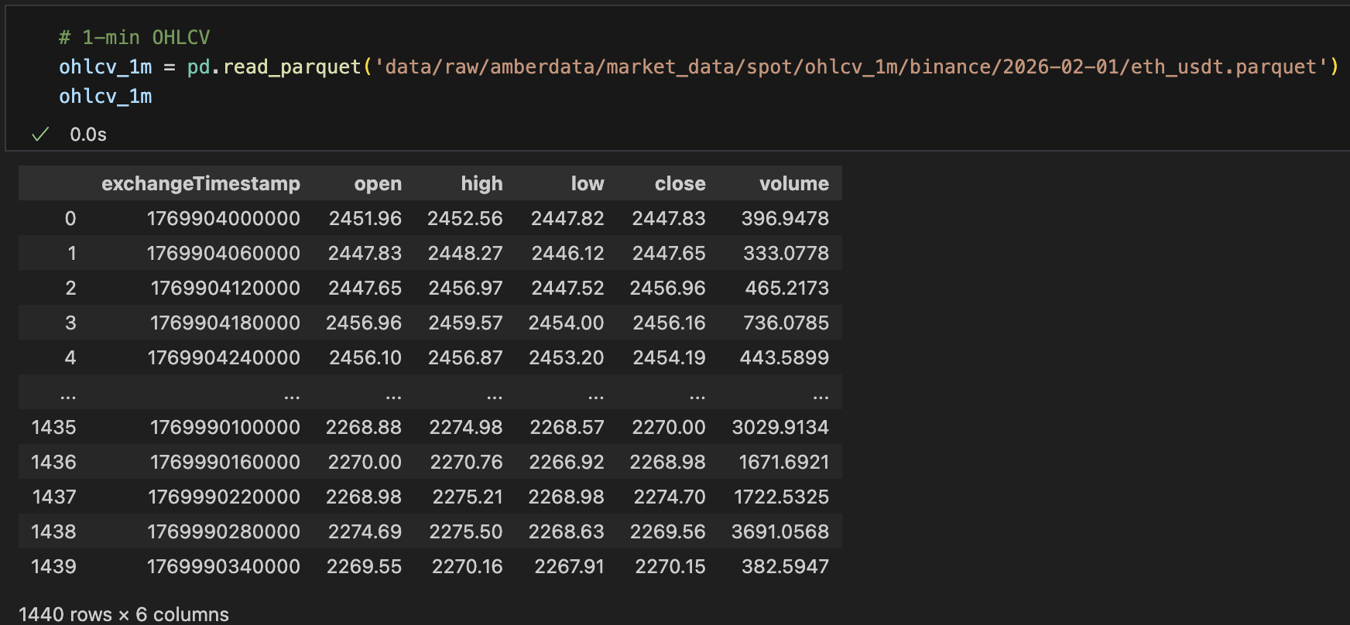
1-MIN OHLCV
Load Data in Python

Slide 37
ORDER BOOK (1-MIN SNAPSHOTS)
Definition
An order book is an electronic book, or list, of buy and sell orders for a specific asset or instrument. Order Book 1-min Snapshots dataset delivers historical order book snapshots for specified Spot market trading pairs, including detailed bid and ask levels, volume, and order count per price level, along with timestamps to track market depth over time.
Sample Data (ETH/USDT, Binance, 2026-02-01)
sequence | exchangeTimestampNanoseconds | exchangeTimestamp | timestamp | ask_price | ask_volume | ask_numOrders | bid_price | bid_volume | bid_numOrders
69778867498 | 290019 | 1769904000499 | 1769904000000 | 2451.93 | 33.4367 | None | 2451.92 | 2.4135 | None
69778867498 | 290019 | 1769904000499 | 1769904000000 | 2451.94 | 0.7348 | None | 2451.91 | 0.0232 | None
69778867498 | 290019 | 1769904000499 | 1769904000000 | 2451.95 | 0.0043 | None | 2451.86 | 0.0022 | None
69778867498 | 290019 | 1769904000499 | 1769904000000 | 2451.96 | 1.2068 | None | 2451.85 | 0.0022 | None
69778867498 | 290019 | 1769904000499 | 1769904000000 | 2451.97 | 0.0022 | None | 2451.84 | 0.0043 | None

Slide 38
ORDER BOOK (1-MIN SNAPSHOTS)
Standard Order Book Looks Like
 | price | volume | Level
Ask | 2451.97 | 0.0022 | 5
Ask | 2451.96 | 1.2068 | 4
Ask | 2451.95 | 0.0043 | 3
Ask | 2451.94 | 0.7348 | 2
Ask | 2451.93 | 33.4367 | 1
Bid | 2451.92 | 2.4135 | 1
Bid | 2451.91 | 0.0232 | 2
Bid | 2451.86 | 0.0022 | 3
Bid | 2451.85 | 0.0022 | 4
Bid | 2451.84 | 0.0043 | 5
Our dataset
ask_price | ask_volume | bid_price | bid_volume
2451.93 | 33.4367 | 2451.92 | 2.4135
2451.94 | 0.7348 | 2451.91 | 0.0232
2451.95 | 0.0043 | 2451.86 | 0.0022
2451.96 | 1.2068 | 2451.85 | 0.0022
2451.97 | 0.0022 | 2451.84 | 0.0043
Level
1
2
3
4
5

Slide 39
ORDER BOOK (1-MIN SNAPSHOTS)
Order Book Maximum Depth
 | price | volume | Level
Ask | 2458.12 | 0.0002 | 5000
Ask | … | … | …
Ask | … | … | …
Ask | 2451.94 | 0.7348 | 2
Ask | 2451.93 | 33.4367 | 1
Bid | 2451.92 | 2.4135 | 1
Bid | 2451.91 | 0.0232 | 2
Bid | … | … | …
Bid | … | … | …
Bid | 2443.84 | 0.0003 | 5000
Exchange | Spot Data
Binance | 5000
Bitget | 150
BitMart | 50
Bybit | 200
OKX | 1000

Slide 40
ORDER BOOK (1-MIN SNAPSHOTS)
Sample Data (ETH/USDT, Binance, 2026-02-01)
sequence | exchangeTimestampNanoseconds | exchangeTimestamp | timestamp | ask_price | ask_volume | ask_numOrders | bid_price | bid_volume | bid_numOrders
69778867498 | 290019 | 1769904000499 | 1769904000000 | 2451.93 | 33.4367 | None | 2451.92 | 2.4135 | None
69778867498 | 290019 | 1769904000499 | 1769904000000 | 2451.94 | 0.7348 | None | 2451.91 | 0.0232 | None
69778867498 | 290019 | 1769904000499 | 1769904000000 | 2451.95 | 0.0043 | None | 2451.86 | 0.0022 | None
69778867498 | 290019 | 1769904000499 | 1769904000000 | 2451.96 | 1.2068 | None | 2451.85 | 0.0022 | None
69778867498 | 290019 | 1769904000499 | 1769904000000 | 2451.97 | 0.0022 | None | 2451.84 | 0.0043 | None
sequence: A unique identifier for the order book state, provided by the exchange (null if not provided). Each time the order book changes (e.g., an order is added, modified, or removed) (here is 1-min snapshots), the sequence number increments
exchangeTimestamp: The last bid/ask updated timestamp as provided by the exchange
timestamp: The time at which the data vendor captured/recorded this snapshot

Slide 41
ORDER BOOK (1-MIN SNAPSHOTS)
Sample Data (ETH/USDT, Binance, 2026-02-01)
sequence | exchangeTimestampNanoseconds | exchangeTimestamp | timestamp | ask_price | ask_volume | ask_numOrders | bid_price | bid_volume | bid_numOrders
69778867498 | 290019 | 1769904000499 | 1769904000000 | 2451.93 | 33.4367 | None | 2451.92 | 2.4135 | None
69778867498 | 290019 | 1769904000499 | 1769904000000 | 2451.94 | 0.7348 | None | 2451.91 | 0.0232 | None
69778867498 | 290019 | 1769904000499 | 1769904000000 | 2451.95 | 0.0043 | None | 2451.86 | 0.0022 | None
69778867498 | 290019 | 1769904000499 | 1769904000000 | 2451.96 | 1.2068 | None | 2451.85 | 0.0022 | None
69778867498 | 290019 | 1769904000499 | 1769904000000 | 2451.97 | 0.0022 | None | 2451.84 | 0.0043 | None
exchangeTimestamp: The last bid/ask updated timestamp as provided by the exchange
timestamp: The time at which the data vendor captured/recorded this snapshot
exchangeTimestampNanoseconds: The nanoseconds part of the exchangeTimestamp (null if not provided by an exchange)

Slide 42
ORDER BOOK (1-MIN SNAPSHOTS)
Sample Data (ETH/USDT, Binance, 2026-02-01)
sequence | exchangeTimestampNanoseconds | exchangeTimestamp | timestamp | ask_price | ask_volume | ask_numOrders | bid_price | bid_volume | bid_numOrders
69778867498 | 290019 | 1769904000499 | 1769904000000 | 2451.93 | 33.4367 | None | 2451.92 | 2.4135 | None
69778867498 | 290019 | 1769904000499 | 1769904000000 | 2451.94 | 0.7348 | None | 2451.91 | 0.0232 | None
69778867498 | 290019 | 1769904000499 | 1769904000000 | 2451.95 | 0.0043 | None | 2451.86 | 0.0022 | None
69778867498 | 290019 | 1769904000499 | 1769904000000 | 2451.96 | 1.2068 | None | 2451.85 | 0.0022 | None
69778867498 | 290019 | 1769904000499 | 1769904000000 | 2451.97 | 0.0022 | None | 2451.84 | 0.0043 | None
ask_price/bid_price: The quote price on the ask/bid side
ask_volume/bid_volume: The quantity of the asset available at the specified ask/bid price level
ask_numOrders/bid_numOrders: The number of individual orders aggregated at the specified ask/bid price level (null if not provided by an exchange)

Slide 43
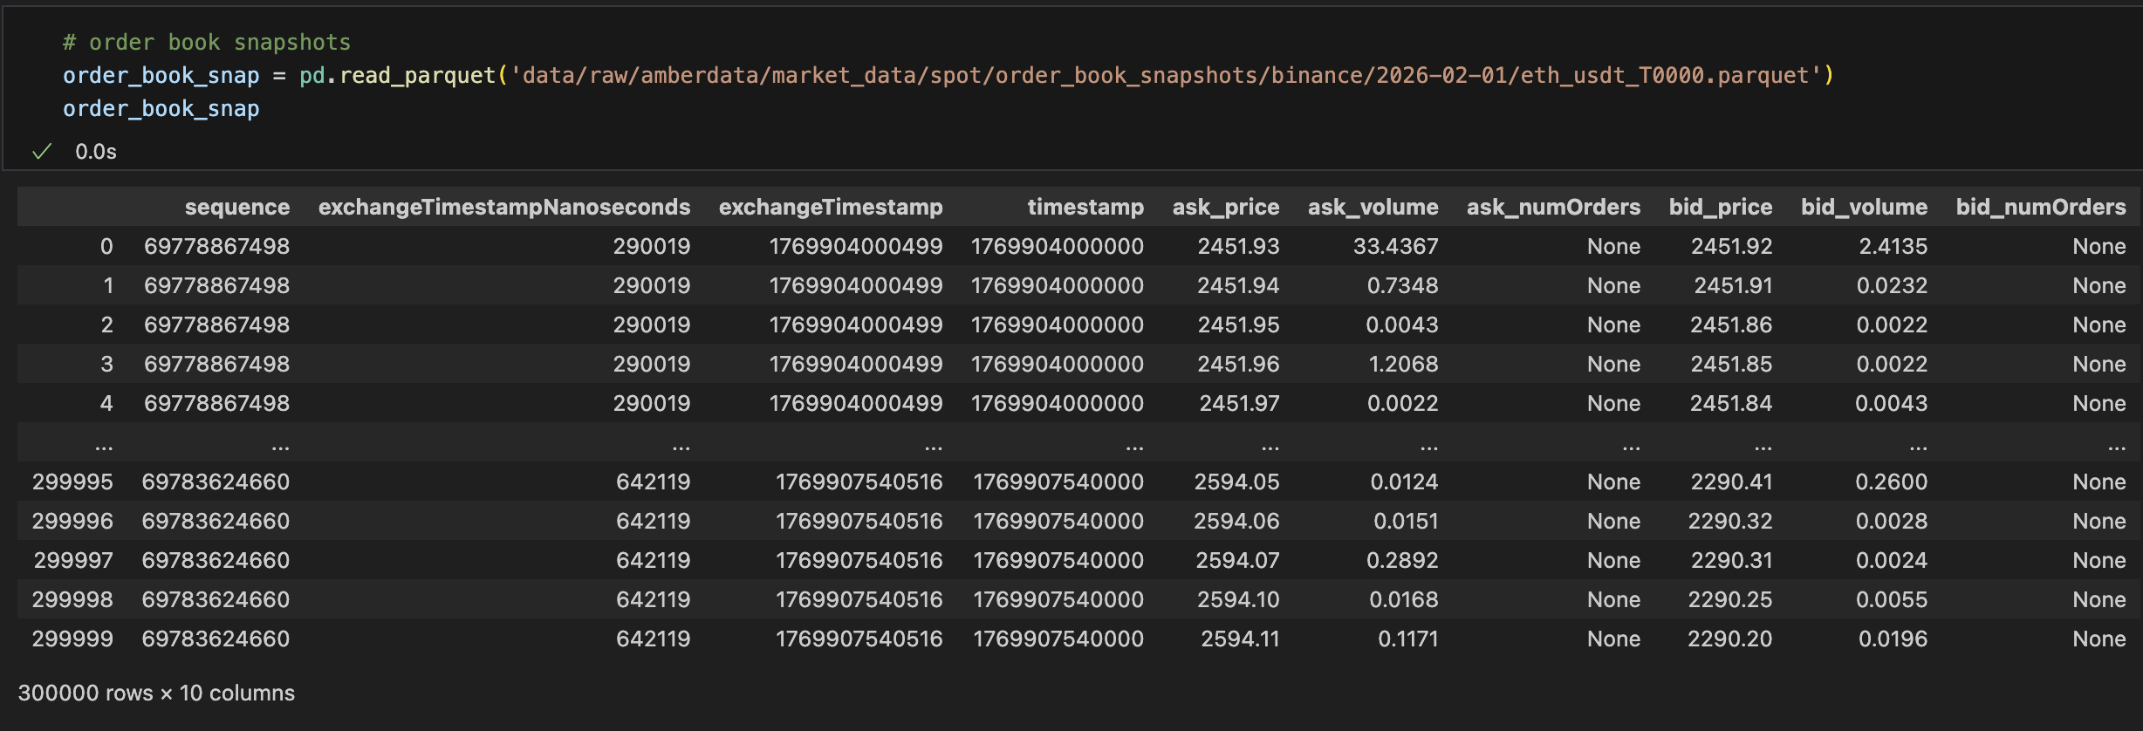
ORDER BOOK (1-MIN SNAPSHOTS)
Load Data in Python

Slide 44
TICK-BY-TICK TRADES
Definition
Trade Data is a general term for tick-by-tick data, or all executed transactions occurring on an exchange. Trade data provides historical trade data for Spot market trading pairs, detailing individual trade prices, volumes, buy/sell indicators, and timestamps to track transaction activity over time on supported exchanges.
Sample Data (ETH/USDT, Binance, 2026-02-01)
exchangeTimestamp | exchangeTimestampNanoseconds | isBuySide | price | volume | tradeId | sequence | quoteVolume
1769904000015 | 0 | True | 2451.96 | 0.0041 | 3545123530 | None | None
1769904000015 | 0 | True | 2451.96 | 0.0366 | 3545123531 | None | None
1769904000055 | 0 | False | 2451.95 | 0.0041 | 3545123532 | None | None
1769904000055 | 0 | False | 2451.95 | 0.0041 | 3545123533 | None | None
1769904000055 | 0 | False | 2451.95 | 0.0041 | 3545123534 | None | None

Slide 45
TICK-BY-TICK TRADES
Sample Data (ETH/USDT, Binance, 2026-02-01)
exchangeTimestamp | exchangeTimestampNanoseconds | isBuySide | price | volume | tradeId | sequence | quoteVolume
1769904000015 | 0 | True | 2451.96 | 0.0041 | 3545123530 | None | None
1769904000015 | 0 | True | 2451.96 | 0.0366 | 3545123531 | None | None
1769904000055 | 0 | False | 2451.95 | 0.0041 | 3545123532 | None | None
1769904000055 | 0 | False | 2451.95 | 0.0041 | 3545123533 | None | None
1769904000055 | 0 | False | 2451.95 | 0.0041 | 3545123534 | None | None
exchangeTimestamp: The time at which the trade took place, as provided by the exchange
exchangeTimestampNanoseconds: The nanosecond part of the exchangeTimestamp (0 or null if not provided by an exchange)
isBuySide: A boolean indicating the trade direction from the taker's perspective: True for a buy, False for a sell

Slide 46
TICK-BY-TICK TRADES
Sample Data (ETH/USDT, Binance, 2026-02-01)
exchangeTimestamp | exchangeTimestampNanoseconds | isBuySide | price | volume | tradeId | sequence | quoteVolume
1769904000015 | 0 | True | 2451.96 | 0.0041 | 3545123530 | None | None
1769904000015 | 0 | True | 2451.96 | 0.0366 | 3545123531 | None | None
1769904000055 | 0 | False | 2451.95 | 0.0041 | 3545123532 | None | None
1769904000055 | 0 | False | 2451.95 | 0.0041 | 3545123533 | None | None
1769904000055 | 0 | False | 2451.95 | 0.0041 | 3545123534 | None | None
isBuySide
= True (buy) — The taker placed a buy order that matched against a resting sell (ask) order on the order book. The taker is buying the base asset.
= False (sell)— The taker placed a sell order that matched against a resting buy (bid) order on the order book. The taker is selling the base asset.

Slide 47
TICK-BY-TICK TRADES
Sample Data (ETH/USDT, Binance, 2026-02-01)
exchangeTimestamp | exchangeTimestampNanoseconds | isBuySide | price | volume | tradeId | sequence | quoteVolume
1769904000015 | 0 | True | 2451.96 | 0.0041 | 3545123530 | None | None
1769904000015 | 0 | True | 2451.96 | 0.0366 | 3545123531 | None | None
1769904000055 | 0 | False | 2451.95 | 0.0041 | 3545123532 | None | None
1769904000055 | 0 | False | 2451.95 | 0.0041 | 3545123533 | None | None
1769904000055 | 0 | False | 2451.95 | 0.0041 | 3545123534 | None | None
price: The price at which the asset was traded
volume: The total amount of the base asset that was traded
tradeId: The unique identifier for each trade, smaller tradeId happened earlier
sequence: A sequence number for the trade event (can be repeated for multiple trades)
quoteVolume: The total amount of the quote asset traded (i.e., price × volume)

Slide 48
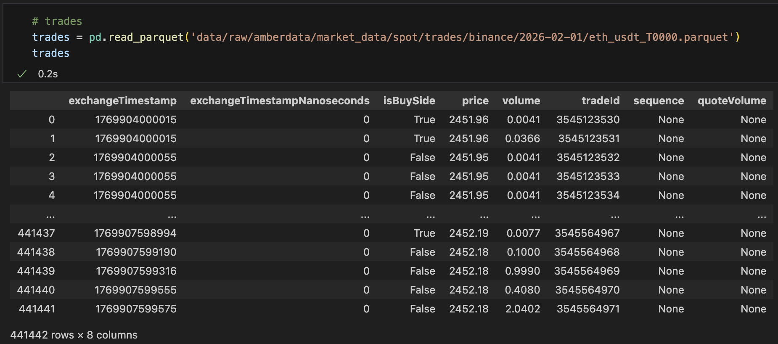
TICK-BY-TICK TRADES
Load Data in Python

